Slide 1

Recommendation System with Machine Learning & deep learning
Kam Hin Ho
Capstone Project
Phrase 1

Slide 2
Main Goal of this project
Apply the following algorithms to provide movie recommendation
Model Based Collaborative Filtering methods (SVD)
Neural Collaborative filtering methods (NCF)
Facebook AI Similarity Search (Faiss)
Compare and interpret results
Accuracy
Performance

Slide 3
Background
With the rise of Youtube, Amazon, Netflix, and many other similar web services, recommendation system have taken more and more place in our lives.
Recommendation system are critical in some industry as it will generate a huge amount of income. If recommendation system predict the right product/services that matches the user preferences, the users tend to spend more money.
Notes:
Recommends related products such as E-commerce
Advertisement
Entertainment

Slide 4
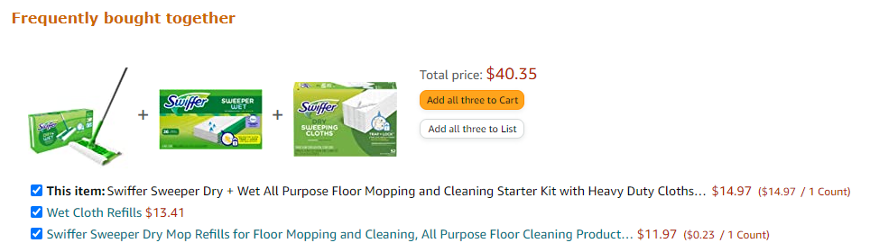
Related products - Amazon
Recommends the related products for the product that user selected

Slide 5
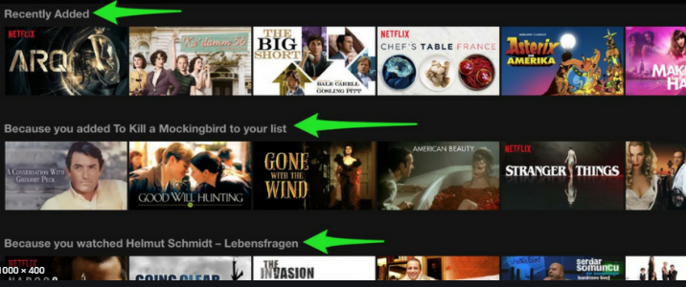
Maximizing user experience - Netflix
Maximizing number of hours streamed
Personalizing the content recommended
→ less cancellation rates
→ Acquisition rate of new users
= More Income

Slide 6

MovieLens Data – 25M
Provided by GroupLens Research from the MovieLens website.
About 25 millions of 5-star rating with over 1 million tag applications across 62423 movies.
The rating data is created by around 160,000 users between January 09, 1995 and November 21,2019.
The data are contained in the files genome-scores.csv, genome-tags.csv, links.csv, movies.csv, ratings.csv and tags.csv.
Notes:
100k dataset will be used to build the model due to performance reason.

Slide 7
Algorithms
After the data preprocessing stage…
Model Based Collaborative Filtering
SVD
The singular value decomposition (SVD) factorizes a matrix, into singular vectors and singular values.
Neural network-based Collaborative Filtering (NCF)
NCF is a generalization of Matrix Factorization.
NCF models the user and item interactions in the latent space effectively with a Neural Network.
Facebook AI Similarity Search – Faiss (If time allows)
Faiss provides several similarity search methods
Faiss is optimized for memory usage and speed.
Faiss offers a state-of-the-art GPU implementation for the most relevant indexing methods.

Slide 8
Comparison of the accuracy and performance
At the end of each algorithm, accuracy and performance will be stored and compared to each other.
The hypothesis is that the NCF may have a better accuracy than Faiss/SVD.
However, the Faiss may have a better performance than the others.

Slide 9
References
F. Maxwell Harper and Joseph A. Konstan. 2015. The MovieLens Datasets: History and Context. ACM Transactions on Interactive Intelligent Systems (TiiS) 5, 4: 19:1–
https://doi.org/10.1145/2827872
https://engineering.fb.com/2017/03/29/data-infrastructure/faiss-a-library-for-efficient-similarity-search/
https://towardsdatascience.com/introduction-to-recommender-systems-6c66cf15ada
https://realpython.com/build-recommendation-engine-collaborative-filtering/

